Slide 1
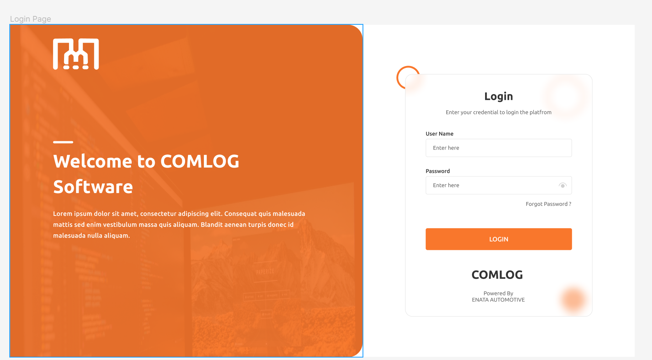
1.When we enter Login Credentials then it will be login and open the Connection Window for Connection Establish

Slide 2
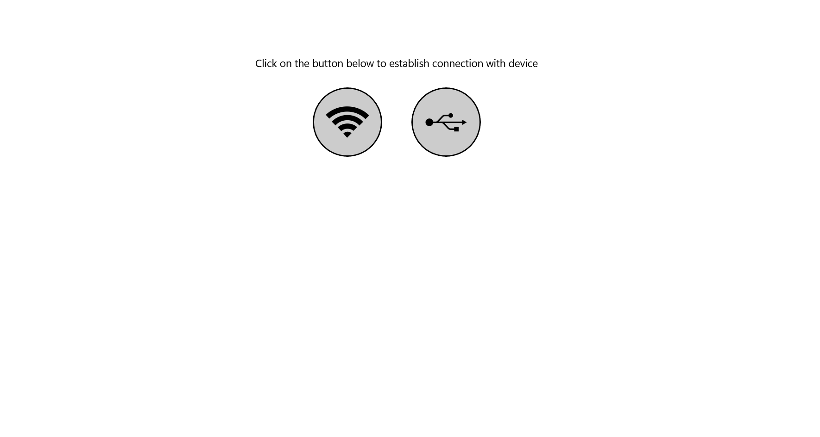
Connection Establish WIFI OR USB
1. If Any Connection Establish then it will be open Home Screen Window

Slide 3
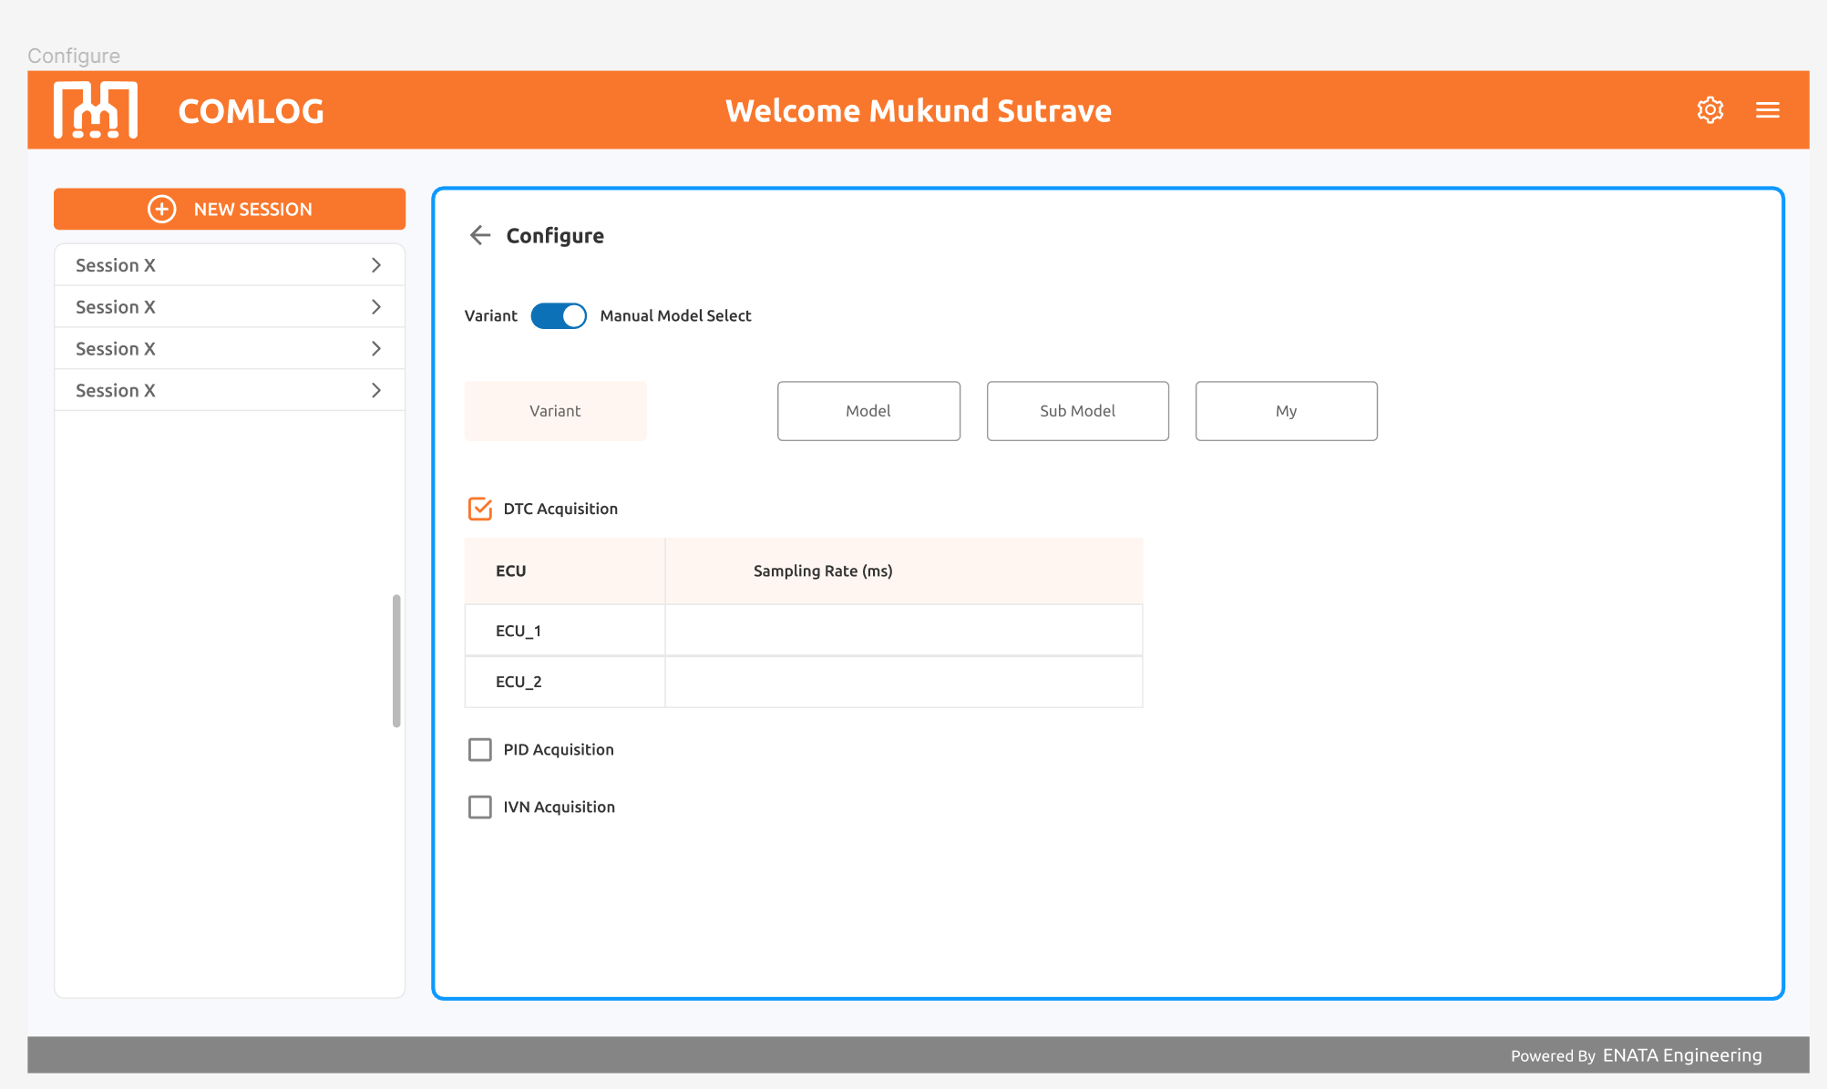
Configure DTC
1.If we create new session then new session create in the list section.
2.Select the created session then it will show configure page.
3.In configure page two modes are there:a)Varient b)Manual
4.If we click Varient then we get multiple varient list.
5.If we select one varient of that multipe list then we get Model,sub-model and model of year (My).
(for ex. Varient-DELPHI ,Model-NEXON ,Submodel-Diesel, Year- 2004)
6.If we click DTC Acquisition -- a) it will show ECU list of that selected varient
b) Then we will enter the sampling rate of that particular ECU’s . For Ex. 1000, 5000
7. Then Enter the Configure DTC Button.

Slide 4
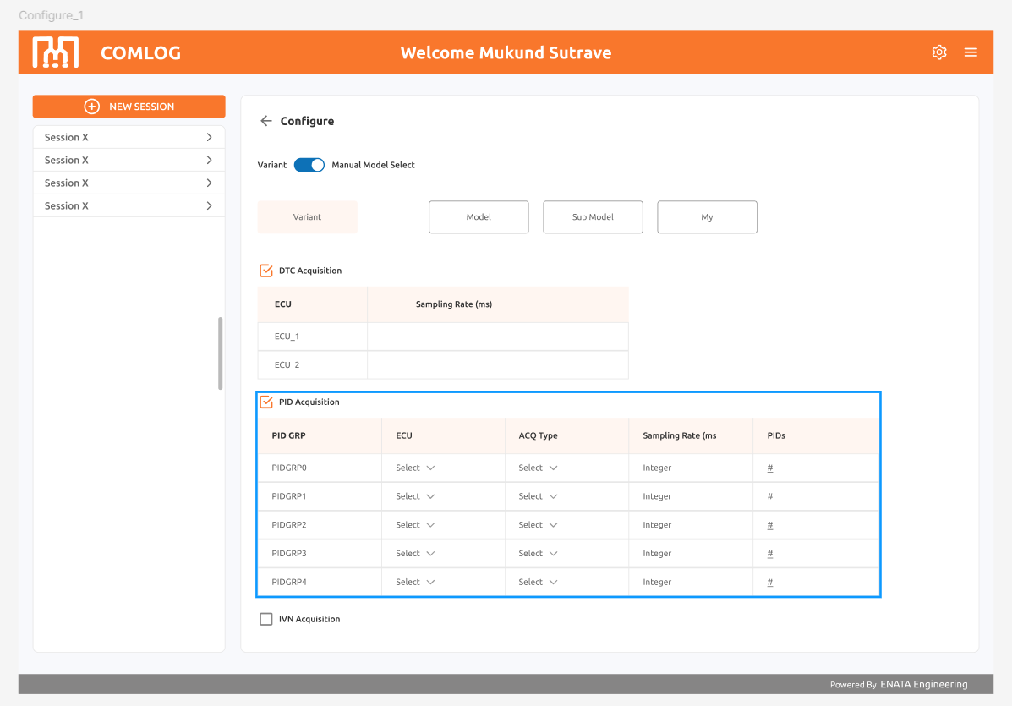
Configure PID
1. If we click PID Acquisition - then it will show the table of PID Group, ECU, ACQ Type, Sampling Rate(MS), PID
2. If we select ECU, ACQ Type,PIDs, they are getting list from *API SIDE*
3. Only Sampling Rate Enter Manually. For Ex.(1000,5000).
4 . If we Click the PID’s Section, It will open the the POPup Window, that shows the next slide.

Slide 5
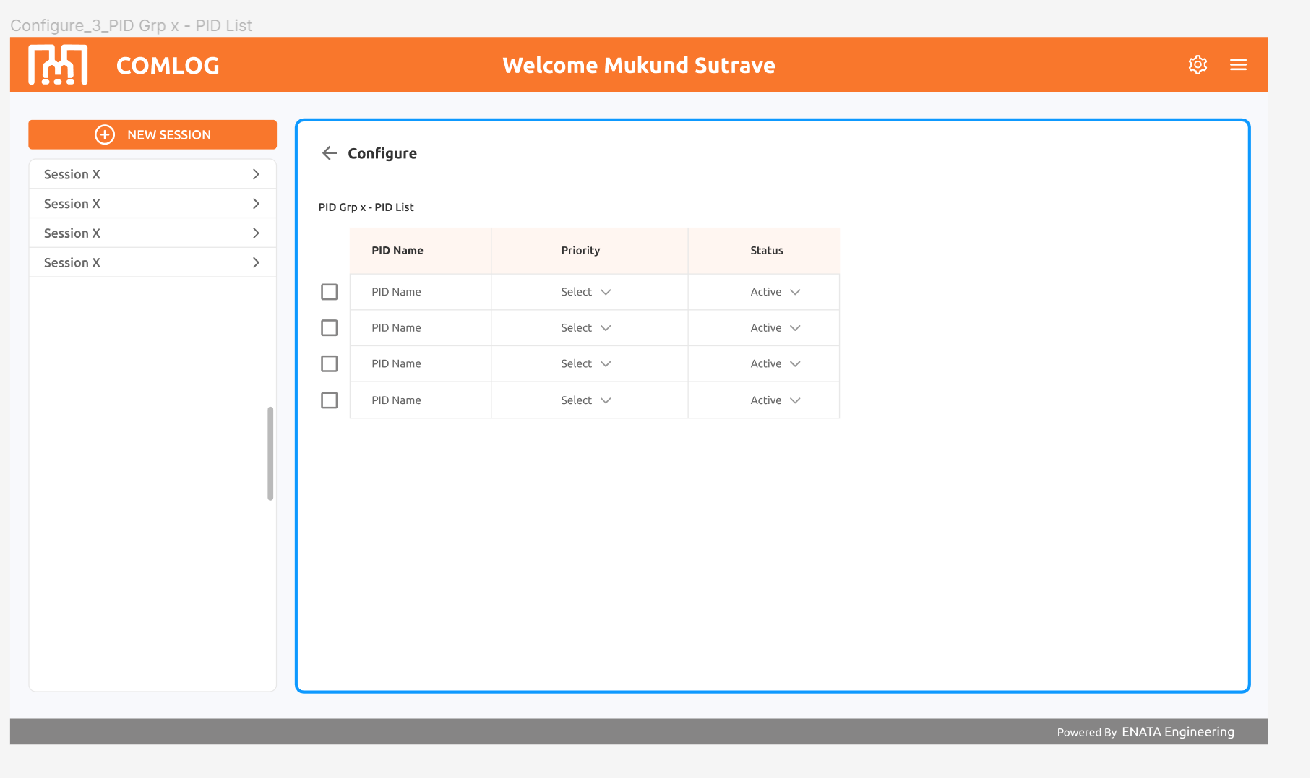
PID Grp : 1) user can configure PID group by selecting PID name , priority , status.
2) All these Data Getting From API Side.
3) After selecting data it will close the pop-up window.
4) Then Enter the Configure PID Button

Slide 6
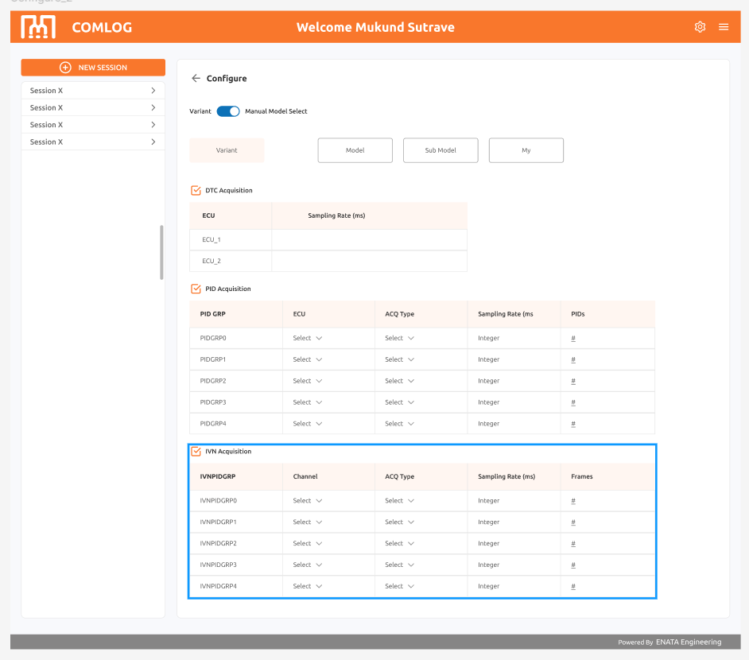
Configure IVN
1. If we click IVN Acquisition
- Then it will show the table of IVN PID Group, Channel, ACQ Type, Sampling Rate(MS), Frames.
2. If we select Channel, ACQ Type,Frames, they are getting list from *API SIDE*.
3. Only Sampling Rate Enter Manually. For Ex.(1000,5000).
4 . If we Click the Frames Section, It will open the POPup Window, that shows the next slide.

Slide 7
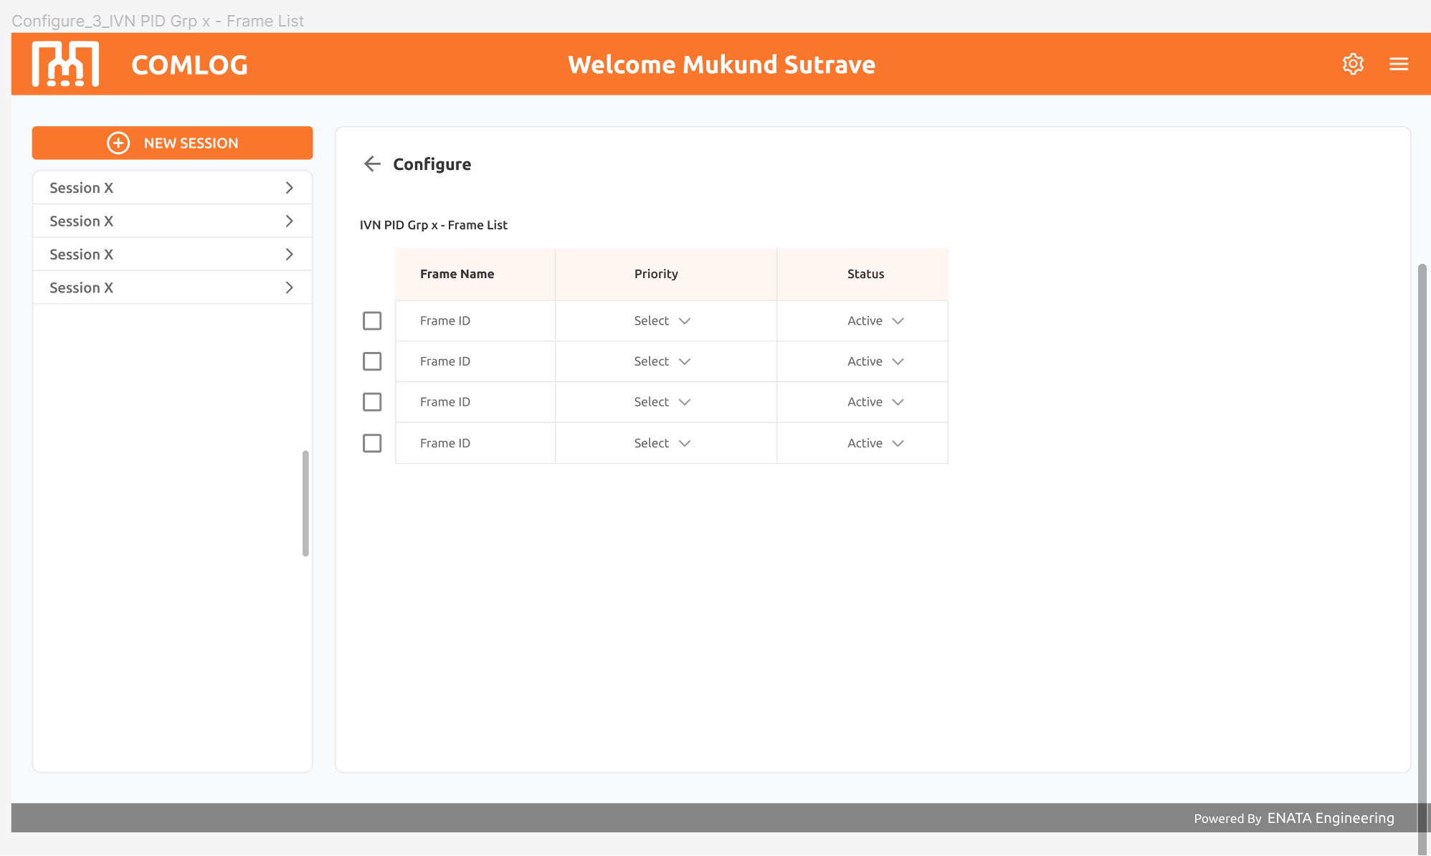
IVN PID Grp : 1) user can configure IVN frames group by selecting FRame ID , priority , status
2) All these Data Getting From API Side.
3) After selecting all Data it will close the pop up window
4) Then Enter the Configure IVN Button

Slide 8
Note: DTC, PID, IVN Configuration
1. If DTC or PID or IVN (if any one configuration is done) then
- Start Acquisition Button Should be Enable.
2. If we click Start Acquisition then, It will Start Reading Data Recording.
3. If we Stop Acquisition then we get Reading Data(From start to Stop)
4. Then we will save that Recorded data file in the Session
5. Then we will select that Recorded file and showing the Graph....
6. It Shown On The Next Slide

Slide 9
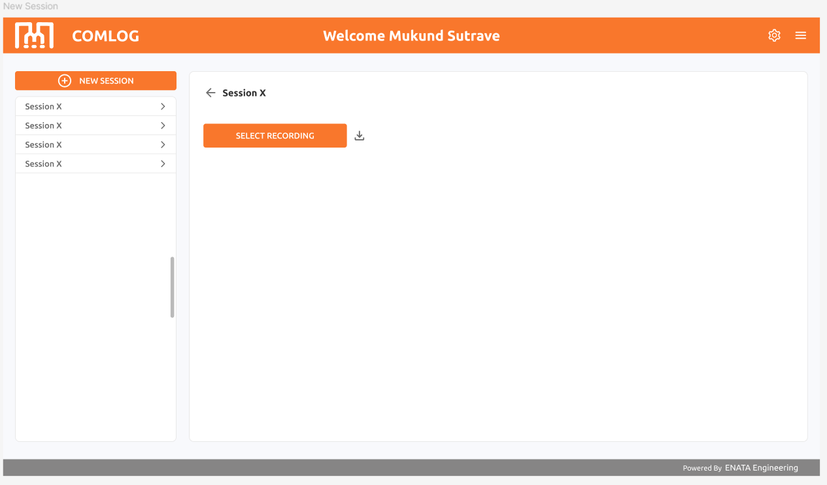

Slide 10
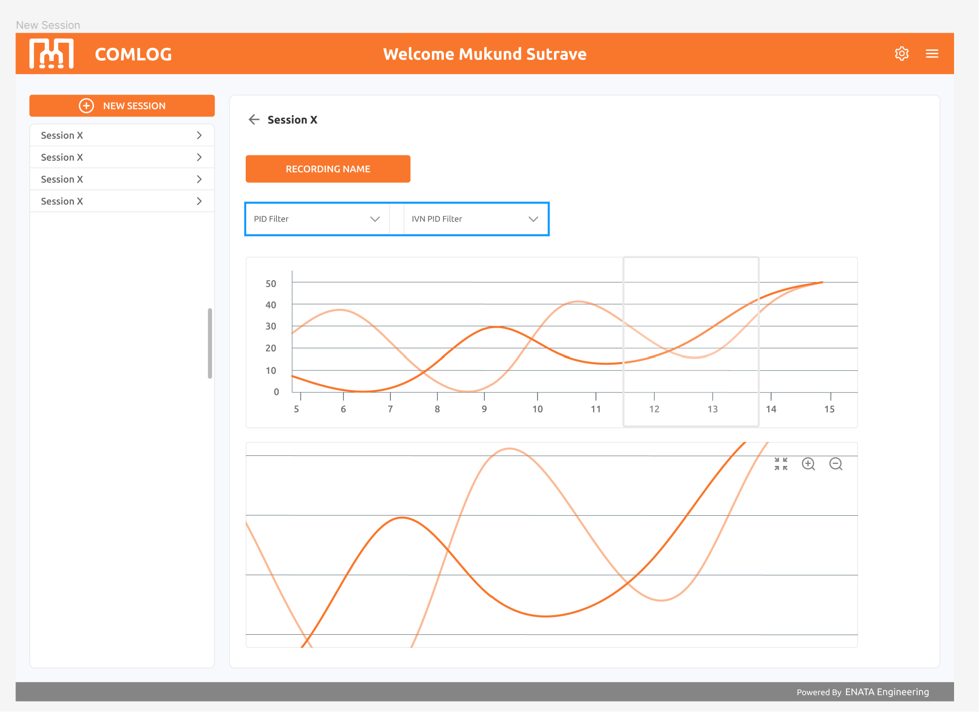
PID filter is for filtering PID using ther PID code, graph will generate of selected PIDs
IVN filter will filter IVN DATA, graph will generate of selected PIDs

